Slide 1
Network Types
> LAN
Let’s
See

Slide 2
Communication
We usually communicate through speech or some crazy tech like this.

Slide 3

HOW PCs Communicate..?
Switch
Computer
Computer

Slide 4

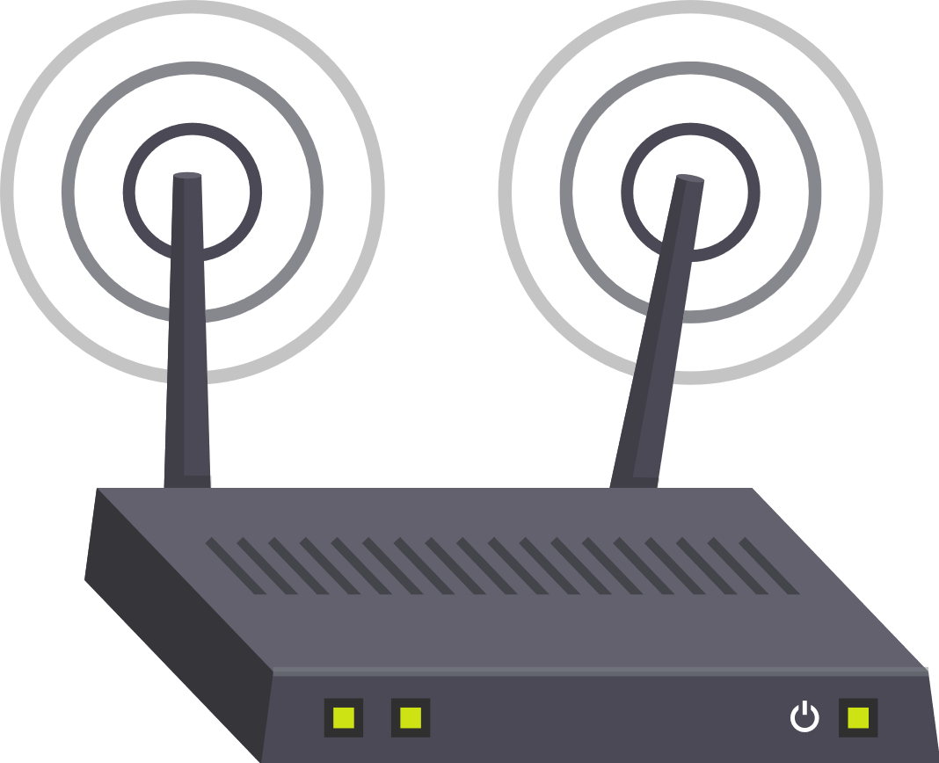
Wired LAN!!
Router
Internet
Switch
Computer
Computer
Computer

Slide 5

CAT5 Cable

Slide 6
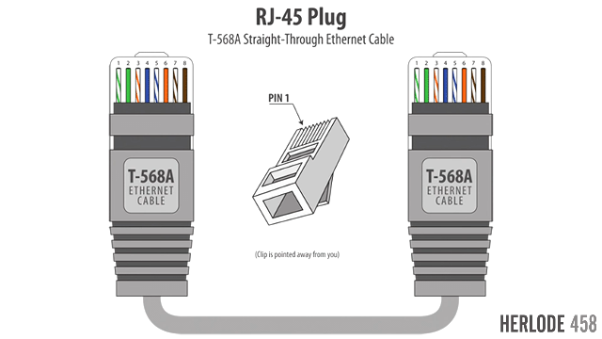

Slide 7
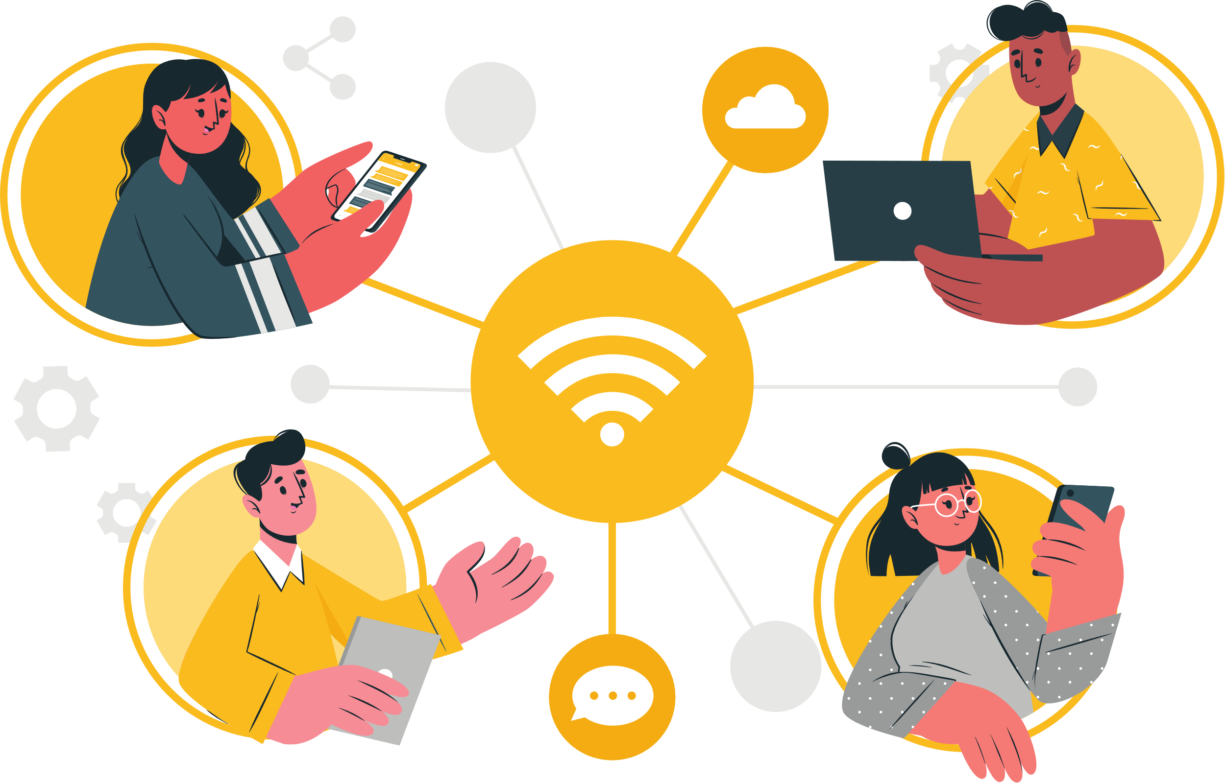
Wireless LAN!!
ALL RIGHT RESERVED © 20008-2020.
Privacy Policy protected

Slide 8
Thank You
Donec eget viverra nisi, non luctus arcu. Sed ipsum leo, volutpat id convallis vitae, mollis ac dui.

